Slide 1
Creating an AWS CI/CD Pipeline for Next.js
Larry Thng
20/10/2023

Slide 2
Background: Next.js & VErcel
What is NextJS? NextJS is a framework used to build applications, built on top of React and Node.
Traditional Deployment: Historically, Next.js applications are predominantly deployed using Vercel.
Vercel's Strength: An out-of-the-box CI/CD platform, Vercel is tailored to facilitate seamless deployment of serverless Next.js applications, especially for developers without an operations background.

Slide 3
Limitations of relying on vercel
Cost: Despite its initial cost-effectiveness, Vercel's pricing can surge substantially upon scaling – particularly once the application exceeds ~200 daily visitors (depending on project complexity).
Vendor Lock-in: There's a strategic need to sidestep potential vendor lock-in when building Next.js applications for real-world applications.
Infrastructure Insight: By relying solely on Vercel, businesses may lack granular insights and control over the underlying AWS infrastructure.
Underlying Infrastructure: Vercel fundamentally operates on AWS, hinting that the same infrastructure capabilities are accessible directly via AWS, if you know how to do it.

Slide 4
Project objective
Motivation: I'm planning to launch a Next.js project soon. Currently tied to Vercel for deployment, this is an opportune moment to try deploying into AWS instead.
Project's Aim: Explore a self-managed AWS-based deployment approach for Next.js that mimics Vercel's efficiency.
Challenge: A lack of comprehensive online resources on this topic underscores the novelty and importance of this undertaking (especially on serverless apps).

Slide 5
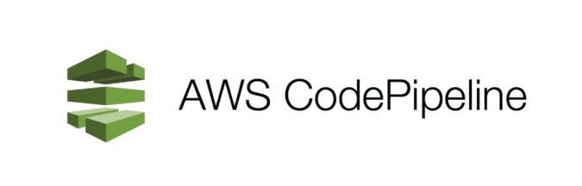
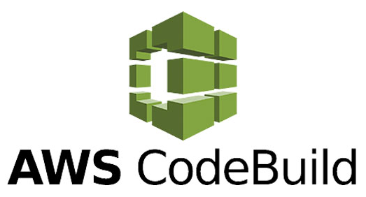
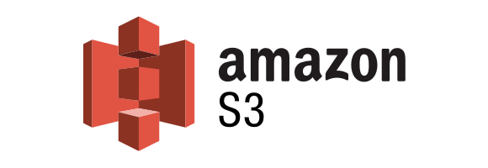
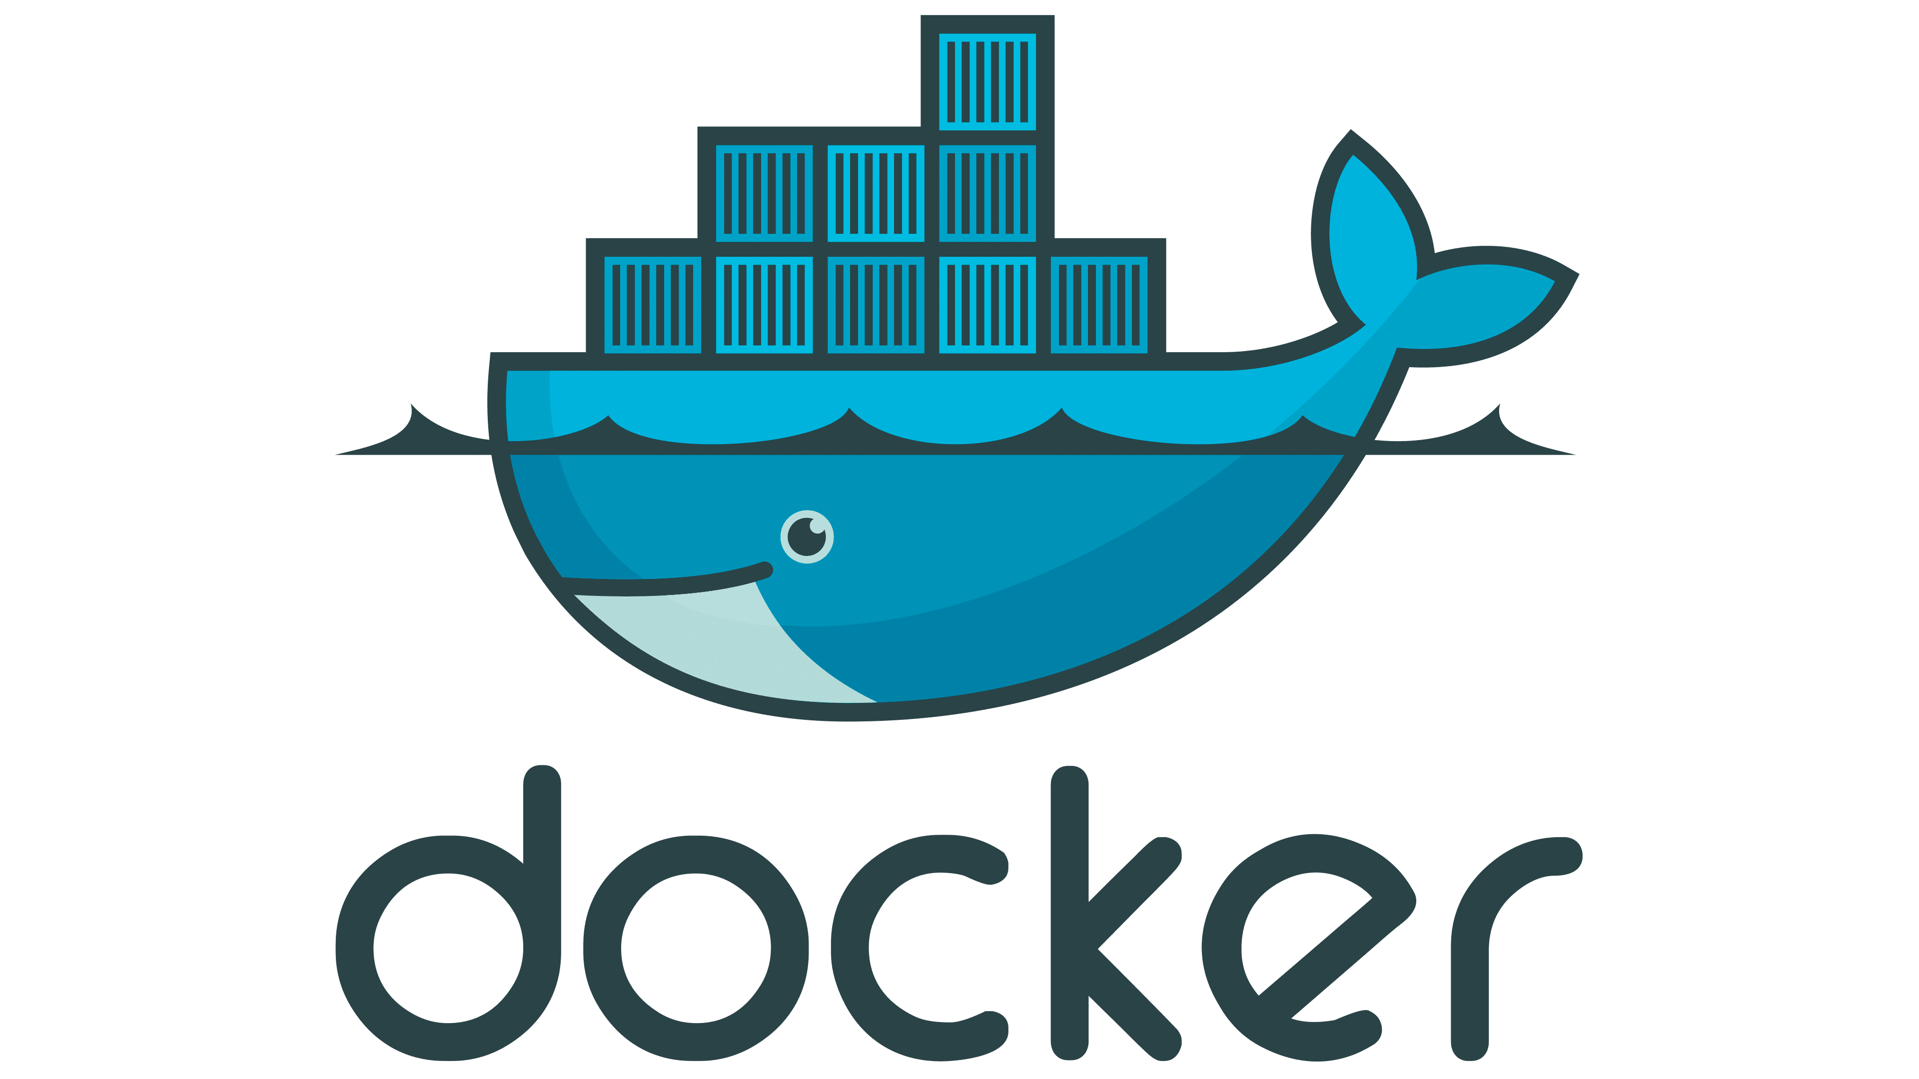
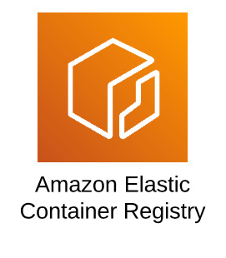
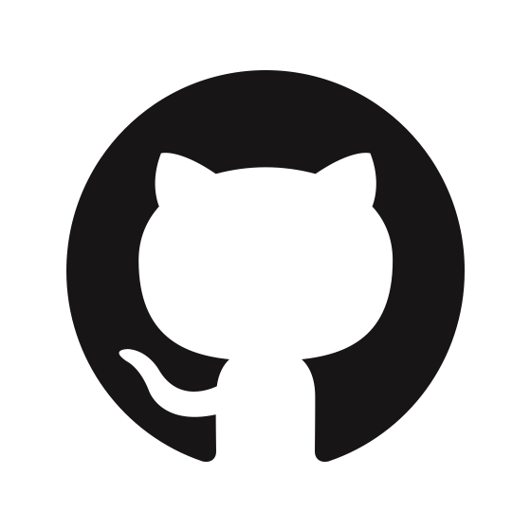

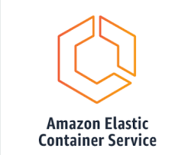

Aws ci/cd pipeline architecture
Triggers process
Commit triggers CodePipeline Webhook
New image trigger
Push commit to GitHub
+ Dockerfile + .dockerignore (for AWS Codebuild later on)
+
+ buildspec.yml (for AWS Code Pipeline later on)
Notes:
Make changes to source code on local machine.
Source code includes Dockerfile, a set of instructions on how to take code and build it in a docker container.
Includes dockerignore, the files to ignore when building Dockerfile
Includes buildspec.yml, a set of instructions for CodePipeline on how to handle the image inside AWS.
When done developing, push code to GitHub.
GitHub: Serves as the code repository for the Next.js application.
Any code commit triggers a Webhook linked to CodePipeline
AWS CodePipeline: acts as the orchestrator for the entire deployment process. It stitches various AWS services into a unified workflow.
AWS CodeBuild**: Upon activation by CodePipeline, it fetches the code, builds a Docker image, and pushes this to AWS S3 as a temporary cache which is then retrieved by ECR.
Elastic Container Registry(ECR): Repository for all Docker images.
Elastic Container Service (ECS): Container management service. It provides orchestration, scheduling, and deployment of Containers.
Fargate: A serverless server for containers, eliminating the need to manage underlying infrastructure. When deploying with ECS, you select Fargate as your launch type.
“Serverless” means that the server’s resources are managed by the provider, in this case AWS.
So serverless server means that Fargate is a server that is managed by AWS.
Upon receiving notification that there is a new image in ECR, ECS will trigger building of the image and deploy it on the Fargate server.
Upon successful deployment, you will get a server IP address, with your app deployed there!

Slide 6
Demo
AWS IP Address: http://3.239.79.36:3000/
GitHub Repo: https://github.com/larrythng96/blog-starter-app

Slide 7
THANK you!
Any questions?

